Slide 1
Operations view of the Java VM
Bill Schwanitz
Presentation available at
https://github.com/bilsch/columbus_devops_presentations

Slide 2
Rough overview
Quick overview of java
Crash course introduction to the Java heap
Crash course on garbage collection ( I’ll keep this very simple )
Common simple tunable/run-time tweaks
Helpful tools
Common exceptions
OutOfMemory
How to read/decrypt an exception
“Just give me more heap!”
Developers like to punt and just ask for more heap. I’ll give you compelling arguments to not give in too quickly

Slide 3
Quick overview of Java
Object-oriented programming language developed by Sun Microsystems
First released in 1995
Inspired/based on c and c++
Original idea was to have a cross-platform just-in-time compiled language.
Write to the Java spec, it should run anywhere
The nasty stuff supposedly gets handled by the Java Virtual Machine
Automatic memory management
At the expense of Garbage Collection

Slide 4
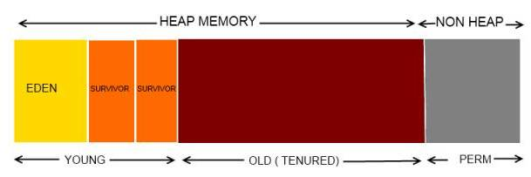
Crash course on Java Heap
Broken out in to sections or generations
Eden, or New/Young generation
Further sub-divided to survivors
Old, or Tenured generation
Perm, or Permanent generation
Disappears in Java 8
Generations have a default size
Based on runtime type, client or server and on JVM version
Notes:
Heap image taken from http://javahash.com/java-memory-model-structures/

Slide 5
Crash course on Garbage collection
non-referenced objects are marked for deletion
Depending on java version, generation and vm type may be run in parallel
Garbage collection event types
Minor GC – happens often and only in Eden
Major GC – happens very infrequently and in Eden, Old and Perm
In Eden
Objects bounce between Survivor 0 and Survivor 1
After surviving for so many minor garbage collections, promotion to Old generation occurs
In Old
Objects are usually only removed in major ( aka stop the world ) garbage collection events
In Perm
Objects never removed unless a full/major gc occurs
Should never see memory shrink!

Slide 6
Common simple tunable/run-time tweaks
Java arg | Action | Value/example | When to change
-Xmx | Sets max heap size | 2g | If you really need to!
-Xms | Sets min heap size | 2g | Any time
-XX:MaxPermSize | Increase permgen size | 256m | If you really need to
-XX:+PrintGCDetails | Turns up logging to stdout of garbage collector | n/a | Debugging mainly but can be used full time with Xloggc
-XX:+PrintGCTimeSTamps | Enhanced output of PrintGCDetails | n/a | ^^
-Xloggc:<file> | Logs gc to alternate log file | /foo/bar | ^^
http://www.oracle.com/technetwork/articles/java/vmoptions-jsp-140102.html
Notes:
http://www.oracle.com/technetwork/articles/java/vmoptions-jsp-140102.html
Note, -client and –server runtime args

Slide 7
Helpful tools
Tool Name | URL
VisualVM | https://visualvm.java.net/
Samurai | http://samuraism.jp/samurai/en/index.html
jmap | included in jdk
jstat | ^^
jstack | ^^
gcviz | https://github.com/Netflix/gcviz
GCViewer | https://github.com/chewiebug/GCViewer
MAT | https://eclipse.org/mat/
Notes:
There are lots more. This gets you started
MAT is likely more useful to developers as it can crack open heap dumps/core files. It’s neat and has a few analysis tools/plugins

Slide 8
Common exceptions
java.lang.OutOfMemoryError: Java heap space
java.lang.OutOfMemoryError: PermGen space
java.lang.OutOfMemoryError: GC overhead limit exceeded
java.lang.NullPointerException

Slide 9
How to read an exception
When a failure occurs in java, unless the developer catches it you get a nasty backtrace
Presented from latest to oldest
Eg most relevant information is on top

Slide 10
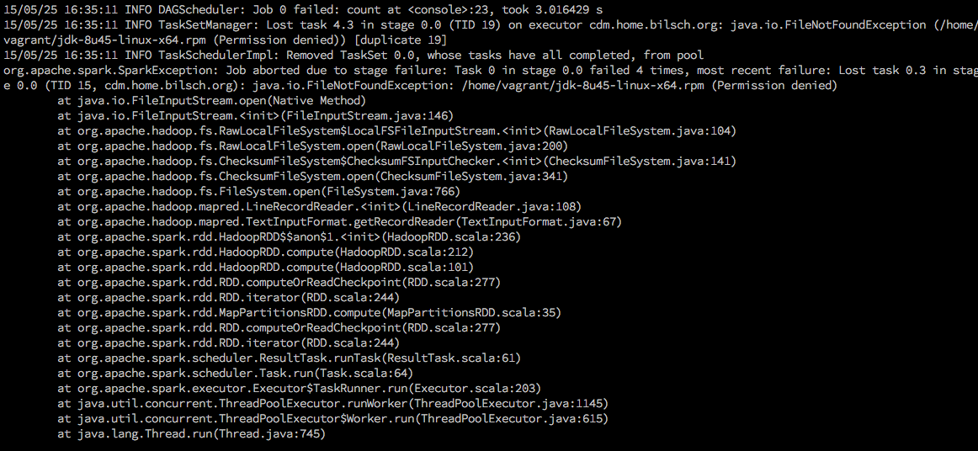
Simple example, permission denied trying to read a file
Simple version of what is going on
Within a java thread in org.apache.spark
Scheduled task trying to iterate over the contents of a file
Bunch of hadoop classes
Top most is java.io.FileInputStream in the open method

Slide 11
Just give me more heap!
I used to get this request a lot!
Keep in mind garbage collection
Bigger heaps mean longer garbage collections
But could also really just be the right answer!
Remember other applications need memory too
Especially the kernel caches/buffers!
Having a bunch of JVMs on a single machine can be problematic when saturating host
Research garbage collector thread allocation!
http://architects.dzone.com/articles/how-tune-java-garbage
Notes:
By default, the parallel garbage collectors will spin up a thread for each ‘processor’ ( /proc/cpuinfo ) per generation. This can lead to thrashing under high load
Java default heap sizes in <= 1.6 jvm were sketchy and prone to issues. Starting in jvm 7 things started to get better

Slide 12
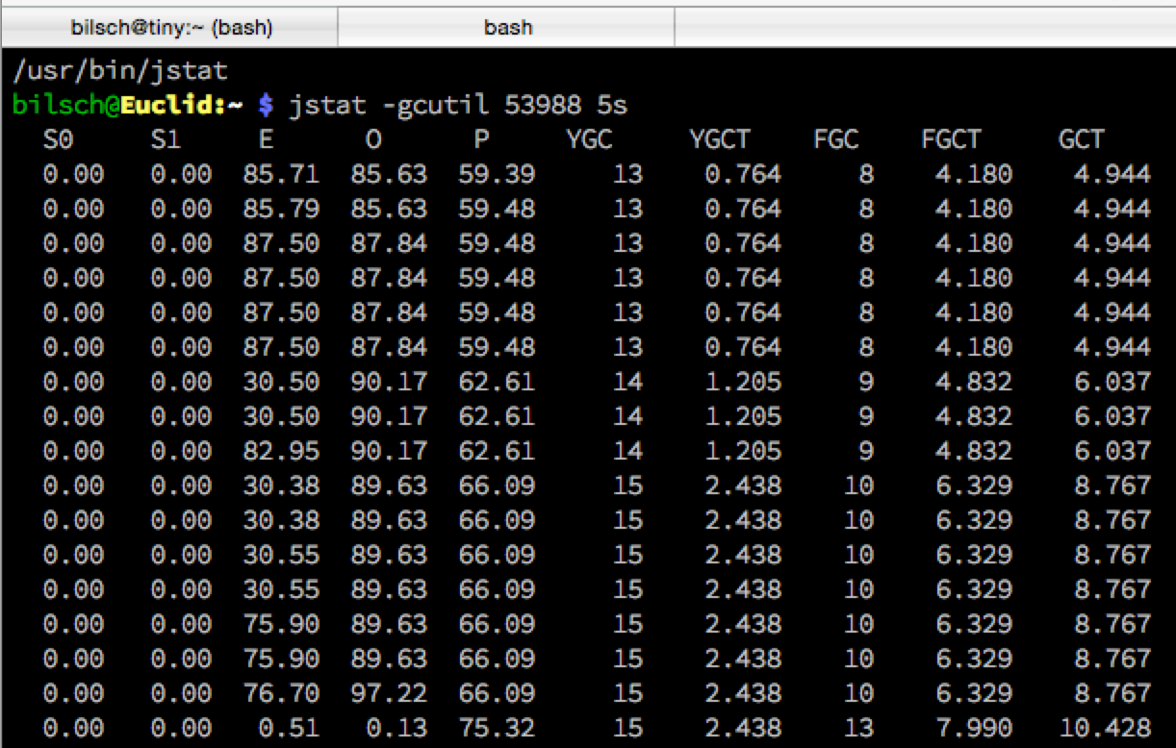
jstat
http://docs.oracle.com/javase/6/docs/technotes/tools/share/jstat.html#output_options
Notes:
http://docs.oracle.com/javase/6/docs/technotes/tools/share/jstat.html#output_options

Slide 13
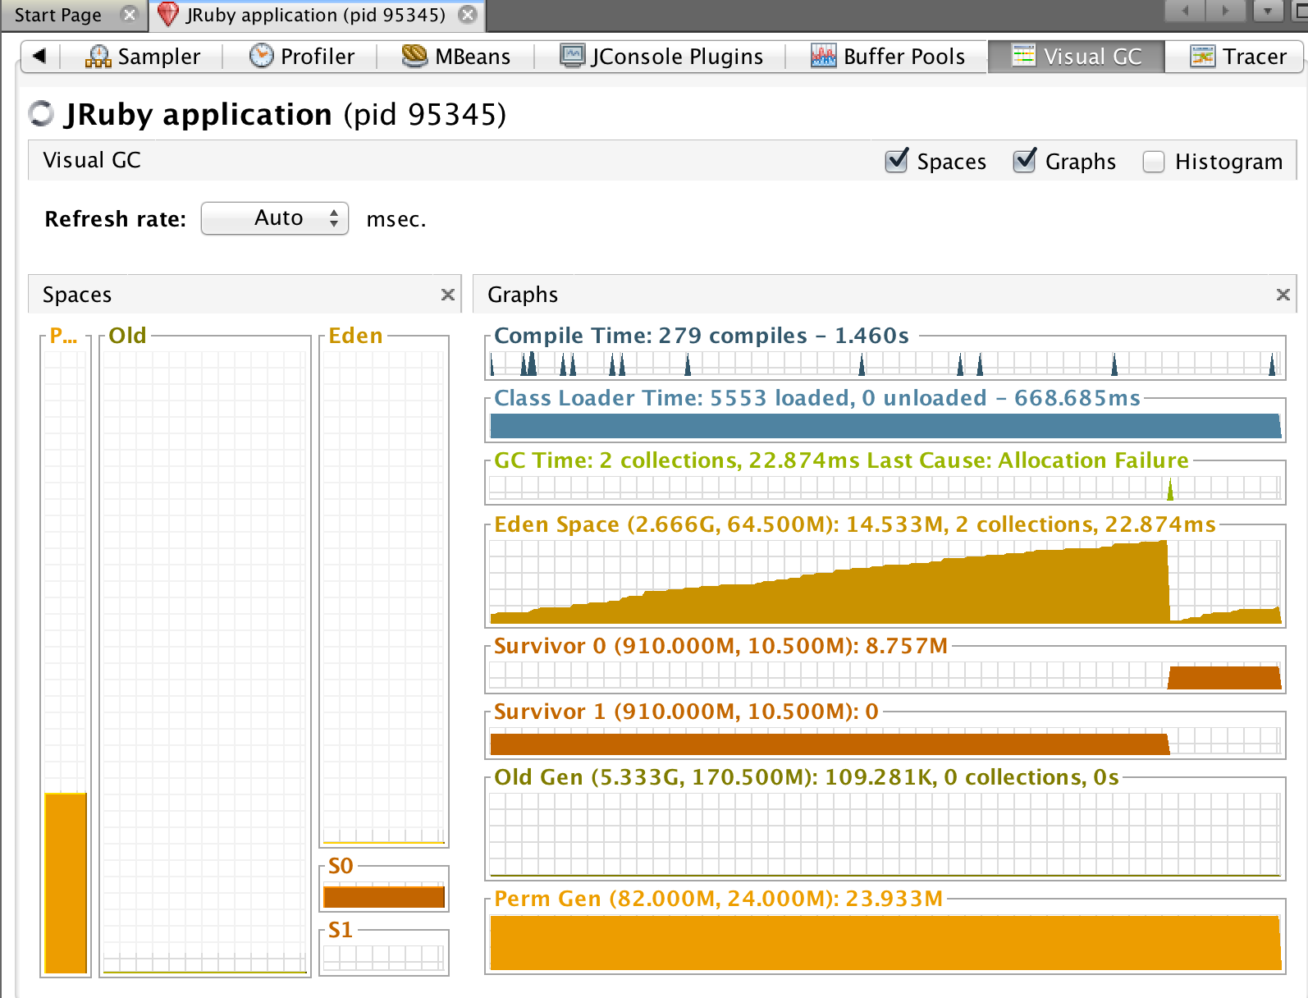
Notes:
Standard garbage collector in java 1.7. only tweak here is the max heap
Note the difference in the values. Eden max is 2.666gb but only allocated 64.5 meg
Also note the “saw tooth” behavior, that’s actually what you are looking for
sign of slow/steady growth. A bunch of objects are created and only a small percentage are promoted to survivor and then to old gen

Slide 14
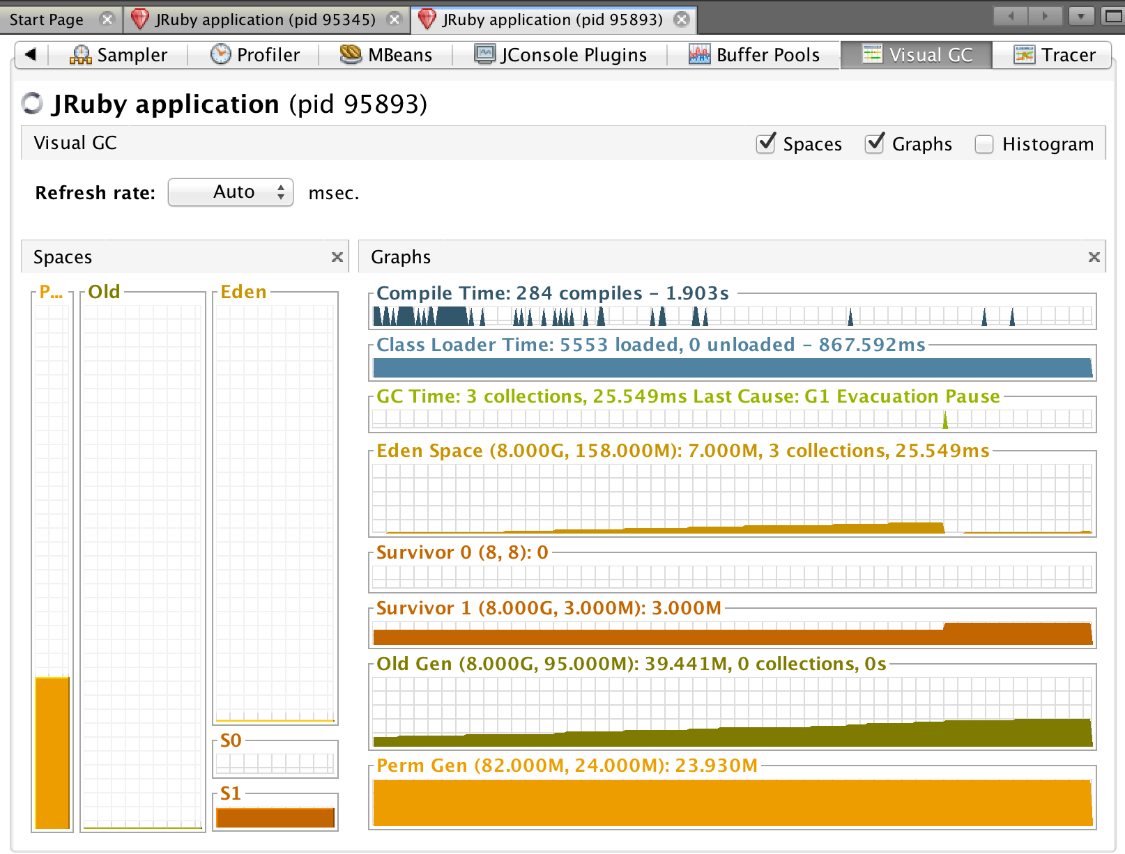
Notes:
Main difference here is the G1 garbage collector being turned on
Note that old gen does grow without lots of churn in the eden/survivors
-XX:+UseG1GC

Slide 15
JMX
Java Management Extensions
Provides access to all kinds of neat stuff
Access to counters/gauges on individual MBeans
Ability to interrogate certain components of the MBean
Toggle runtime
Invoke methods
Trigger a garbage collection
Turn a jdbc pool on/off
Temporarily bump log levels
…

Slide 16
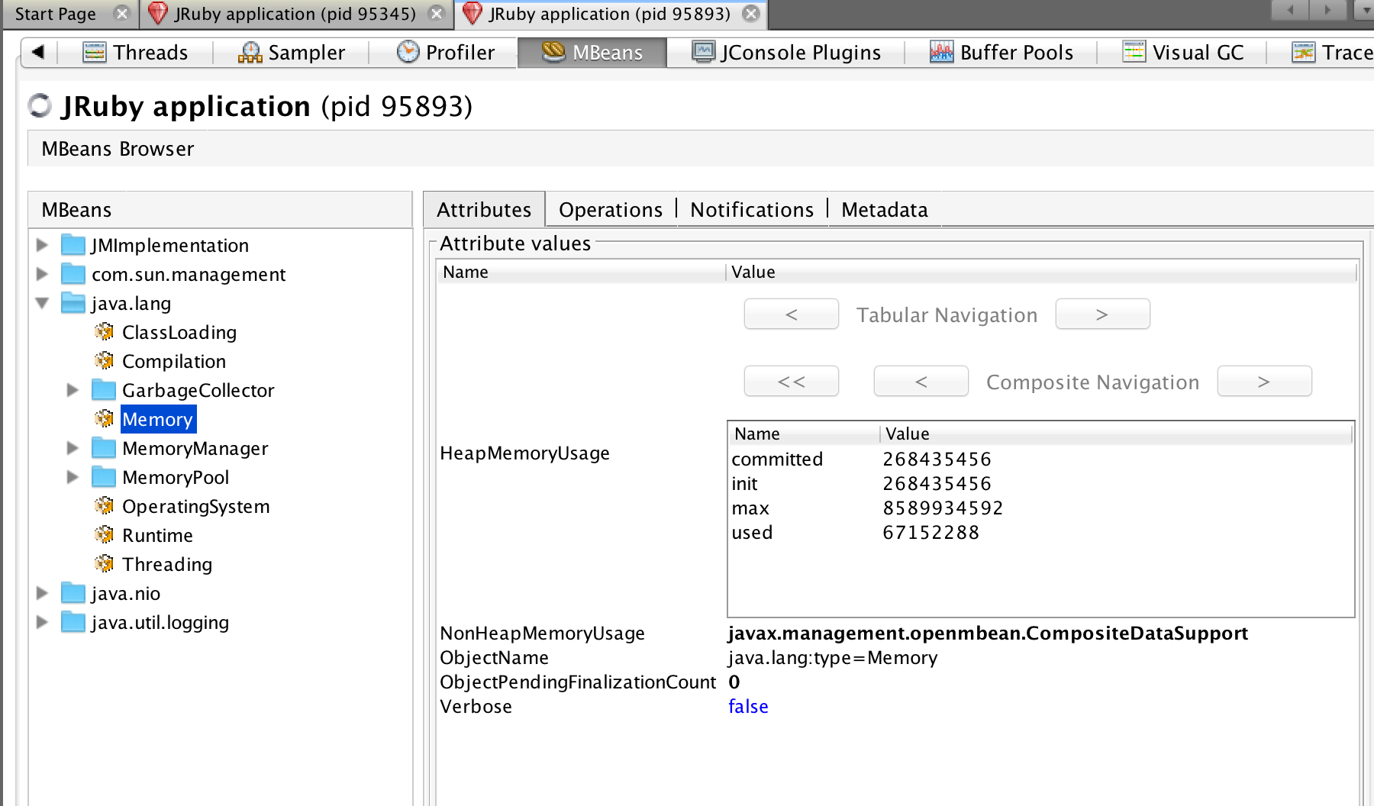
Notes:
Example of a jmx view for over-all java heap usage. Note this is a table/composite data type. In this case, the value column is in bytes
Also note we verbose is false. We could change that to true, just click it and probably select a drop-down of values

Slide 17
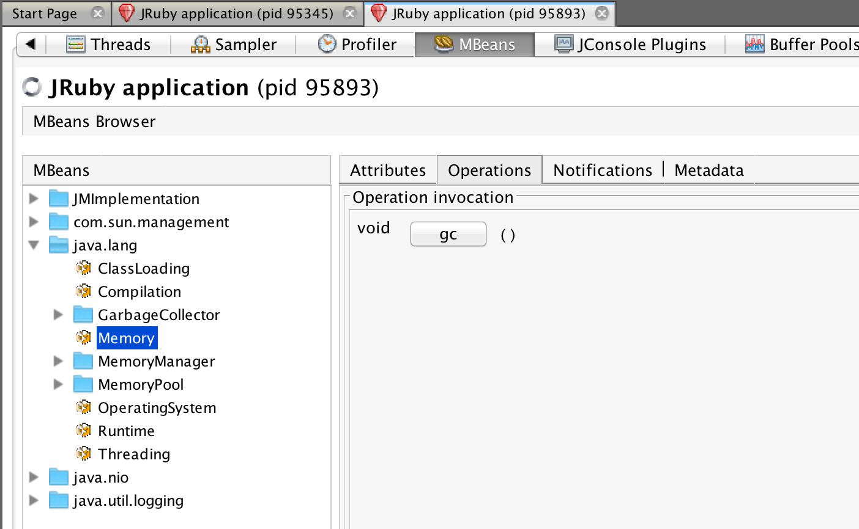

Slide 18
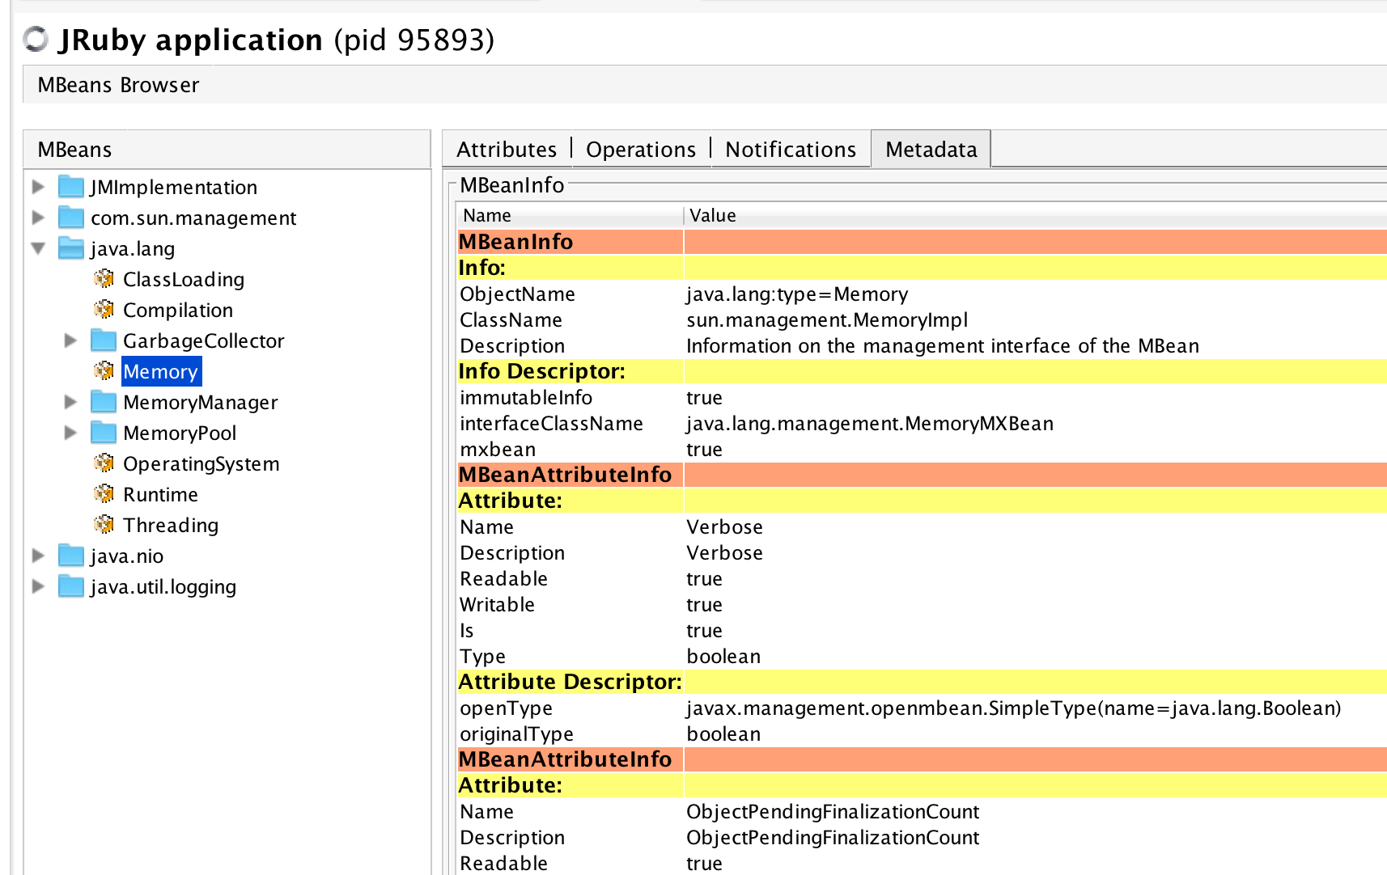
Notes:
Deeper view of the metadata for the memory
Note the attribute Verbose. We can see its java type and whether or not we can tweak it live
ObjectName is of interest here if you want to do JMX

Slide 19
Final thoughts, monitoring
Last thought on JMX. Collectd and others can pull jmx metric data
https://collectd.org/wiki/index.php/Plugin:GenericJMX
Embeds a jvm in to collectd
I found upstream builds do not compile jmx support in
https://exchange.nagios.org/directory/Plugins/Java-Applications-and-Servers/check_jmx/details
https://jolokia.org/index.html
Requires altering the class path and may or may not be liked by vendors
Much lighter weight than the check_jmx as you can get at things with curl vs. invoking a small jvm

